Slide 1
The holiday lodge
By Dj mac

Slide 2
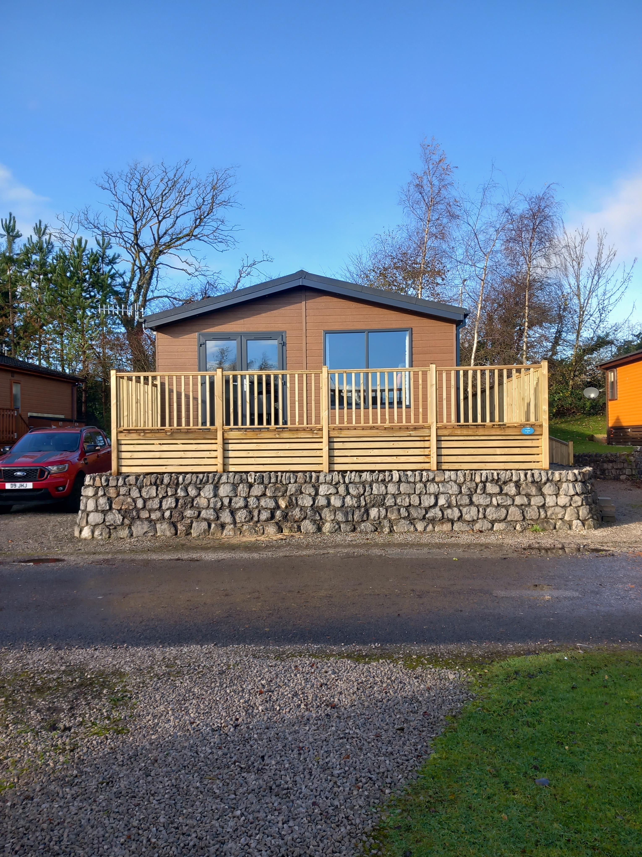

Slide 3
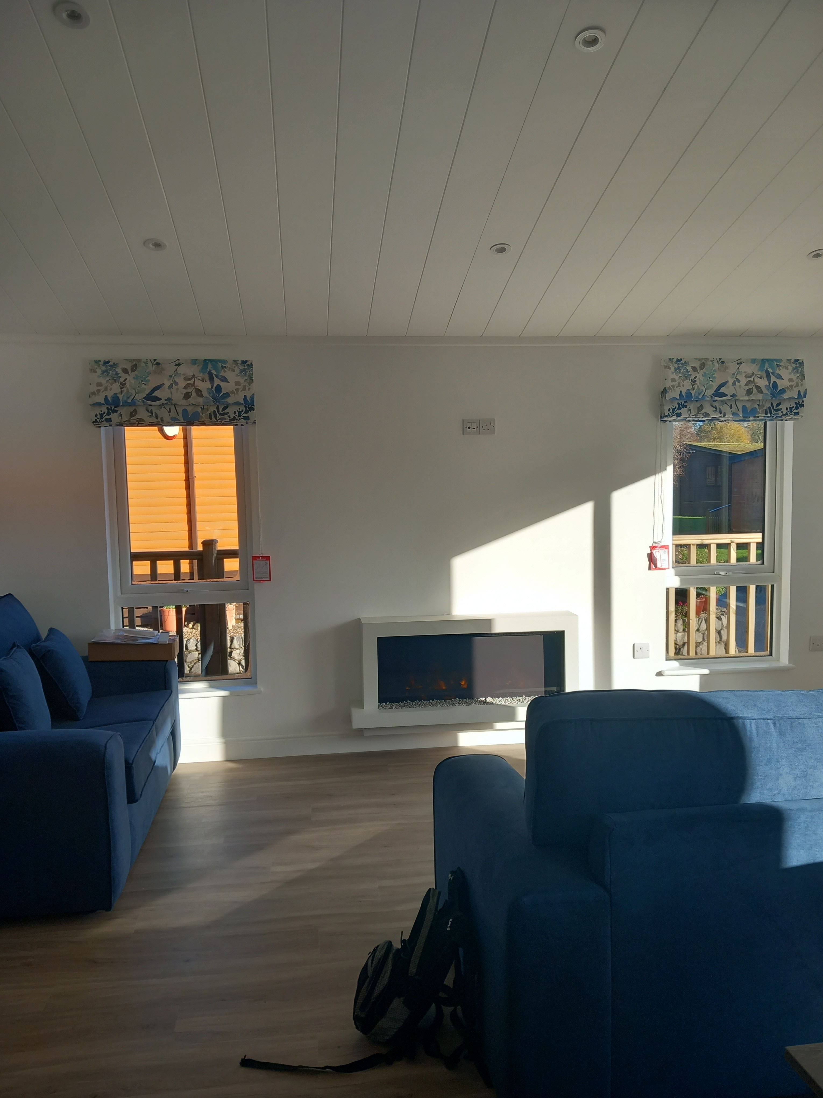

Slide 4
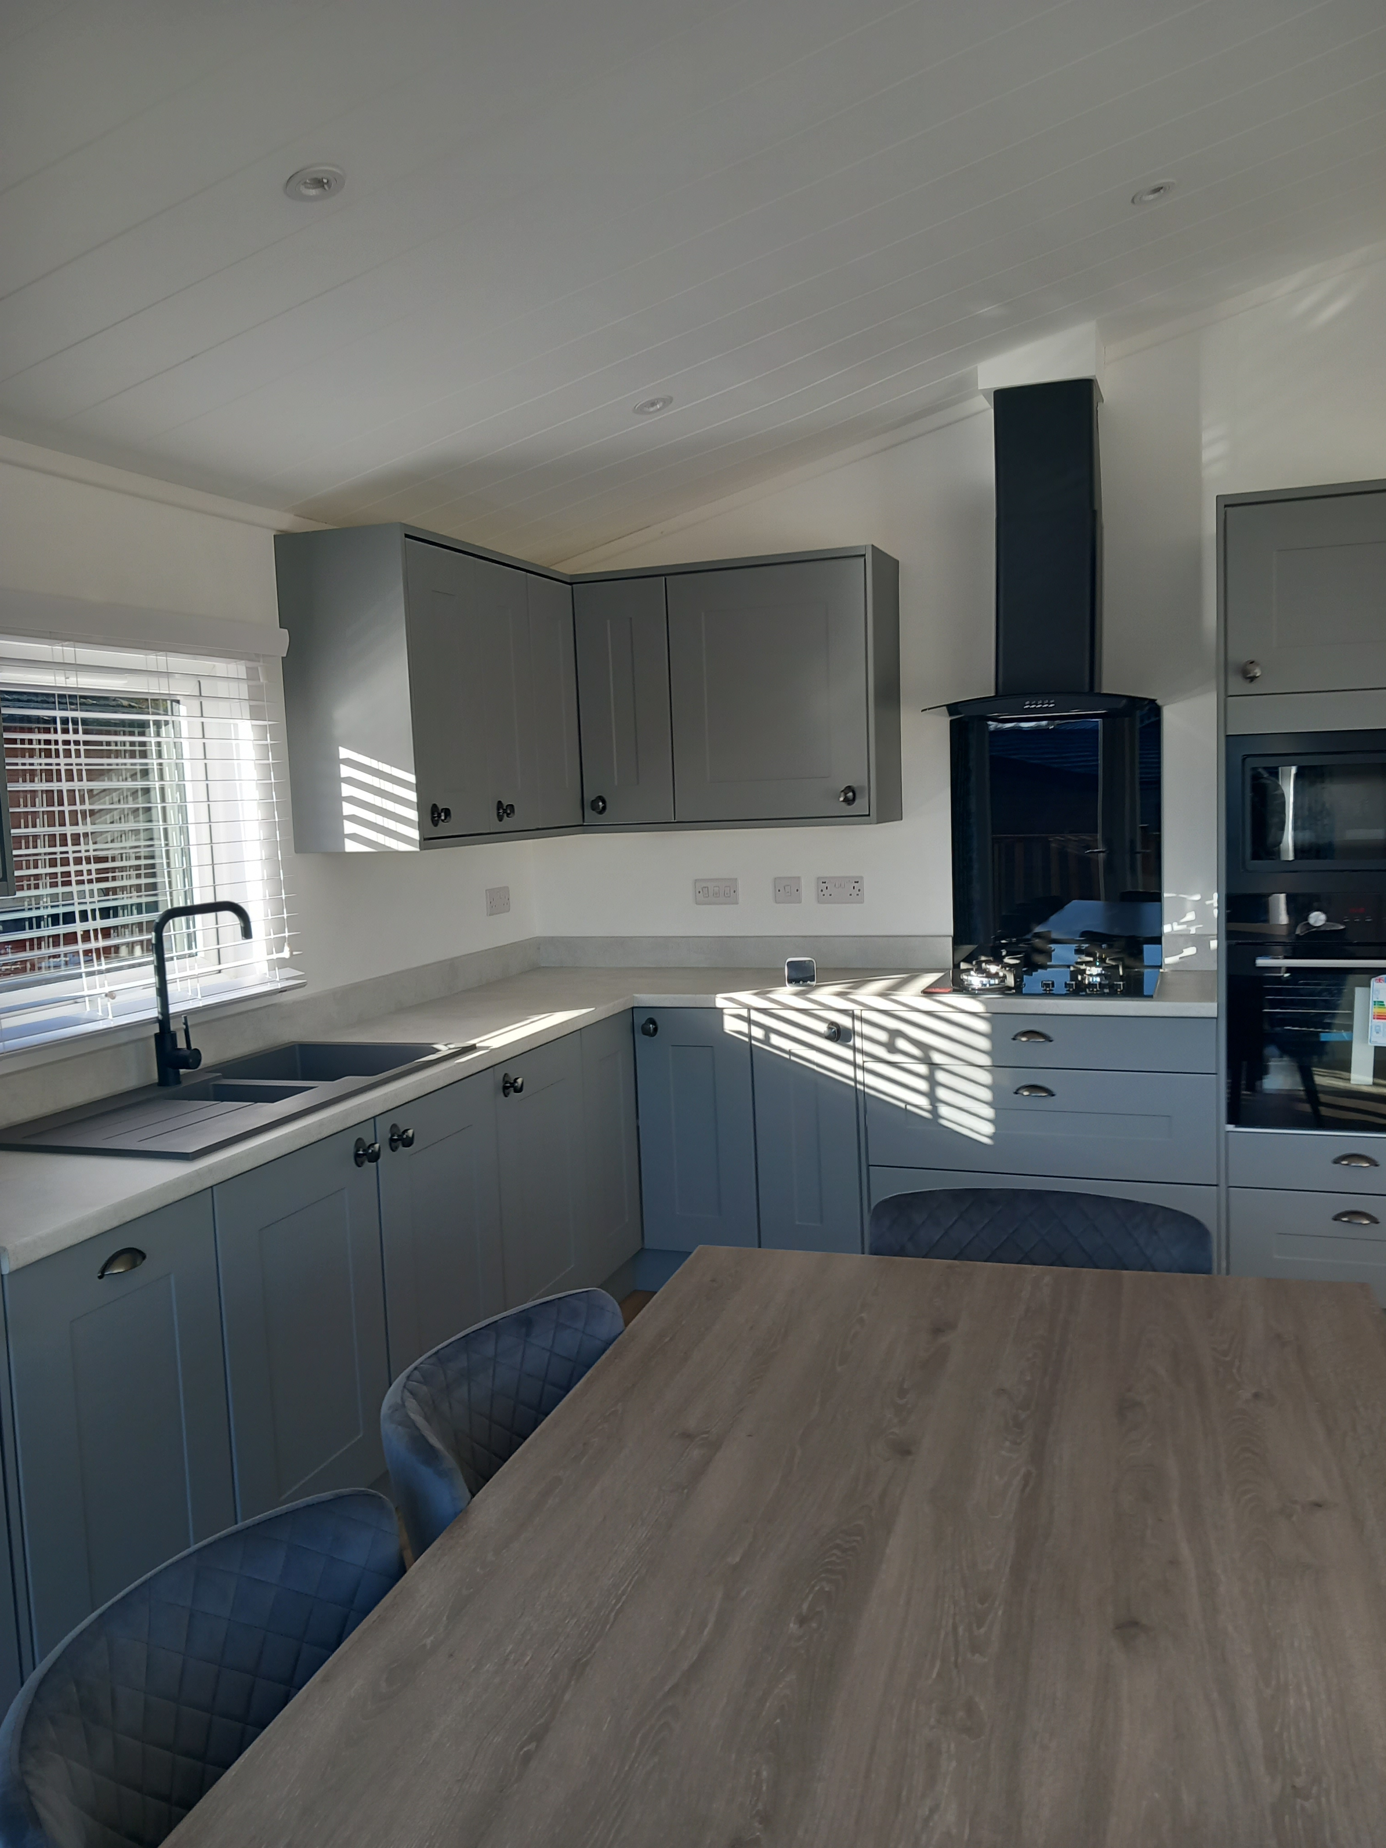

Slide 5
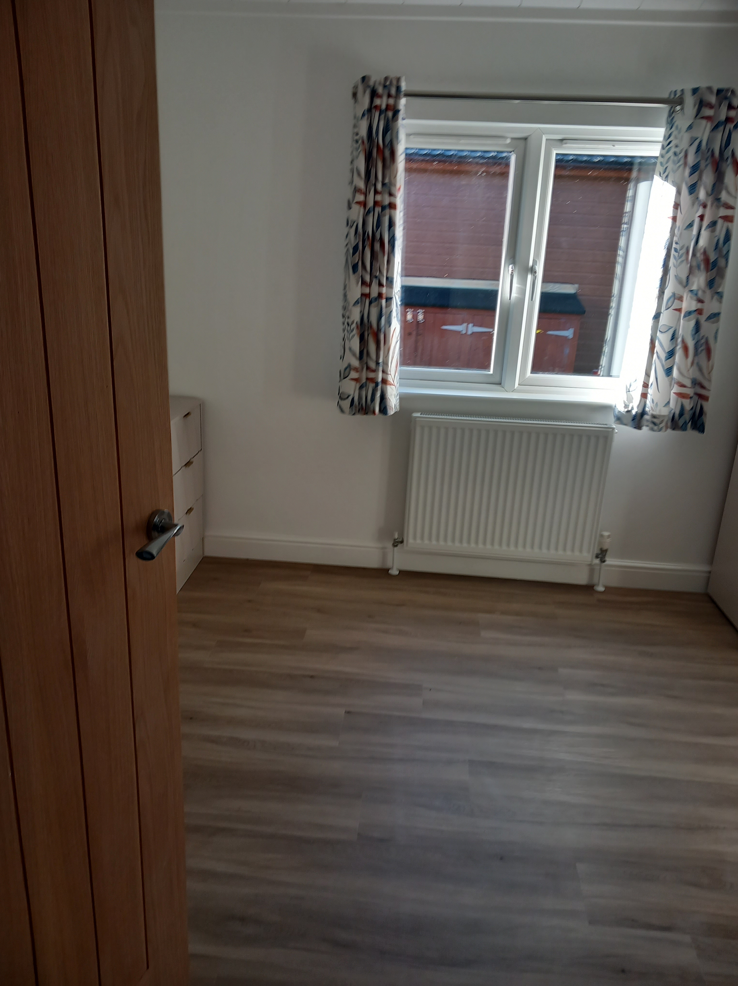

Slide 6
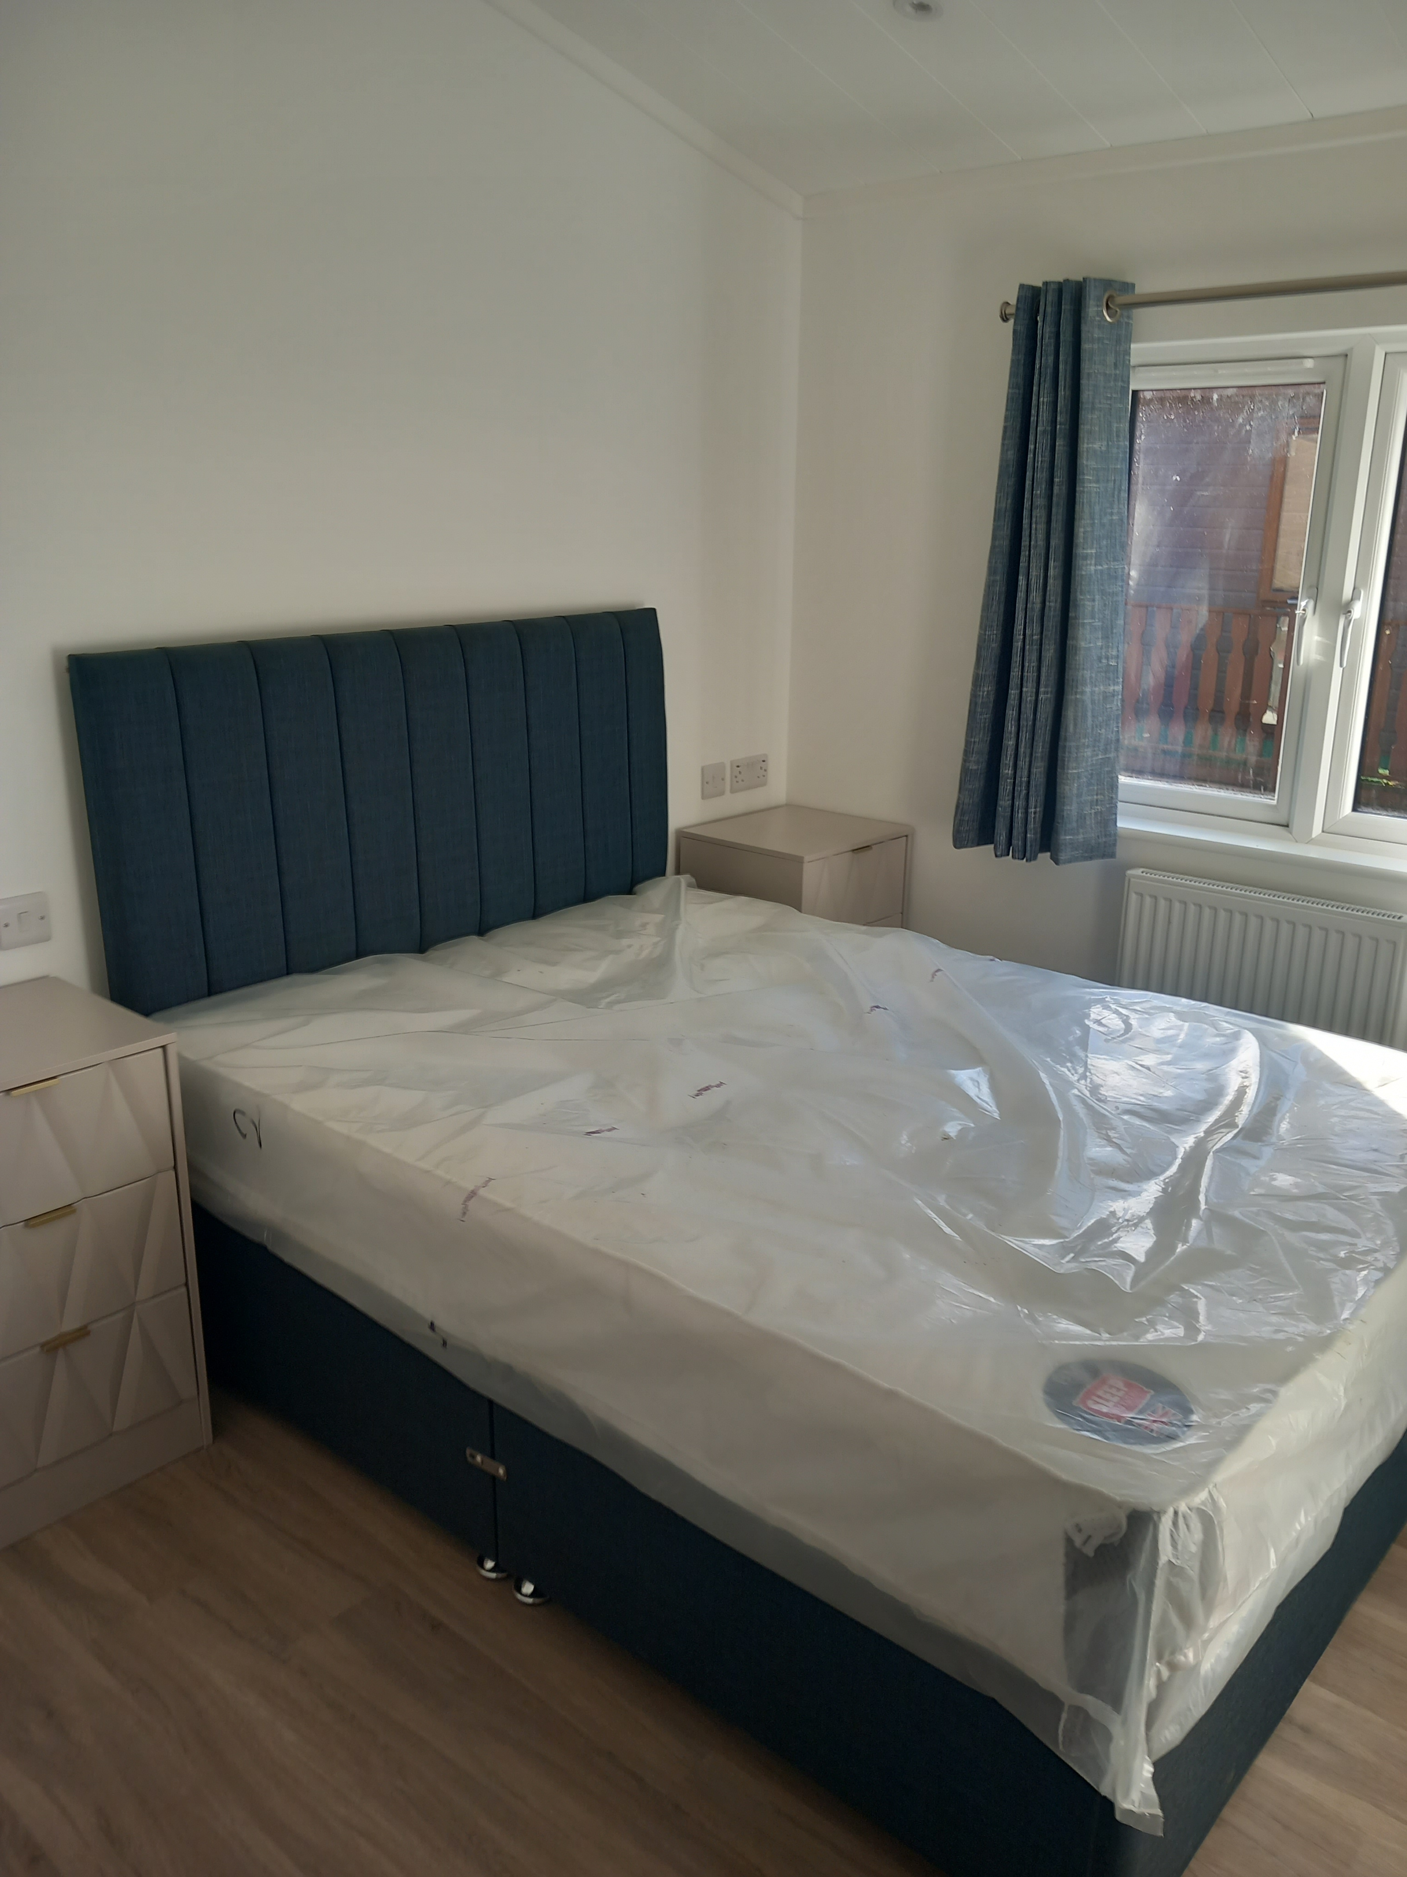

Slide 7
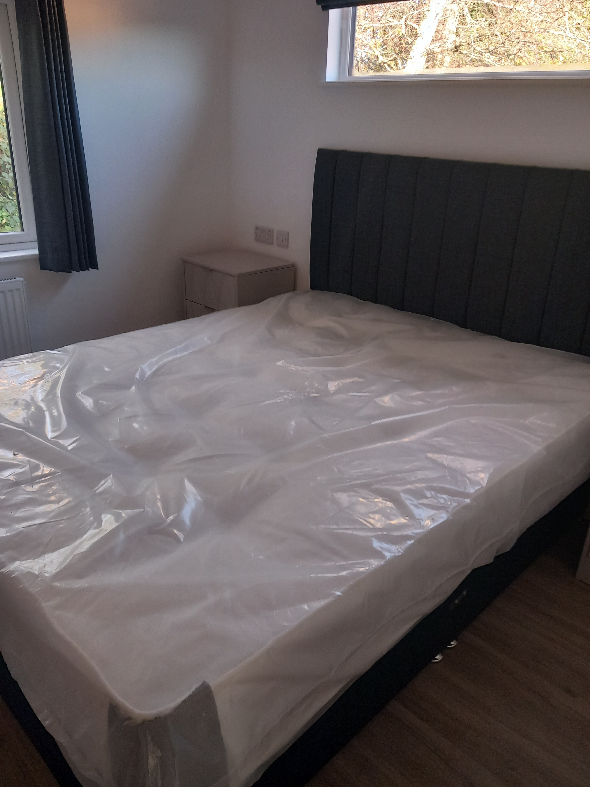

Slide 8
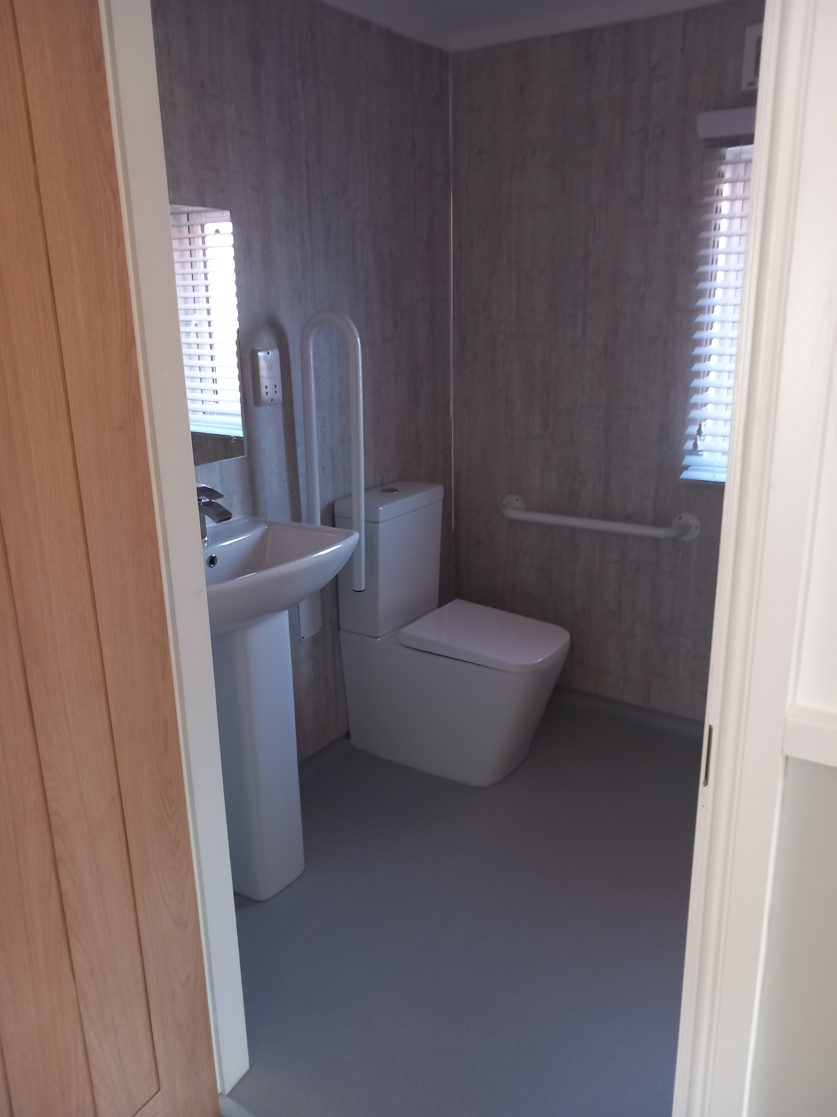

Slide 9
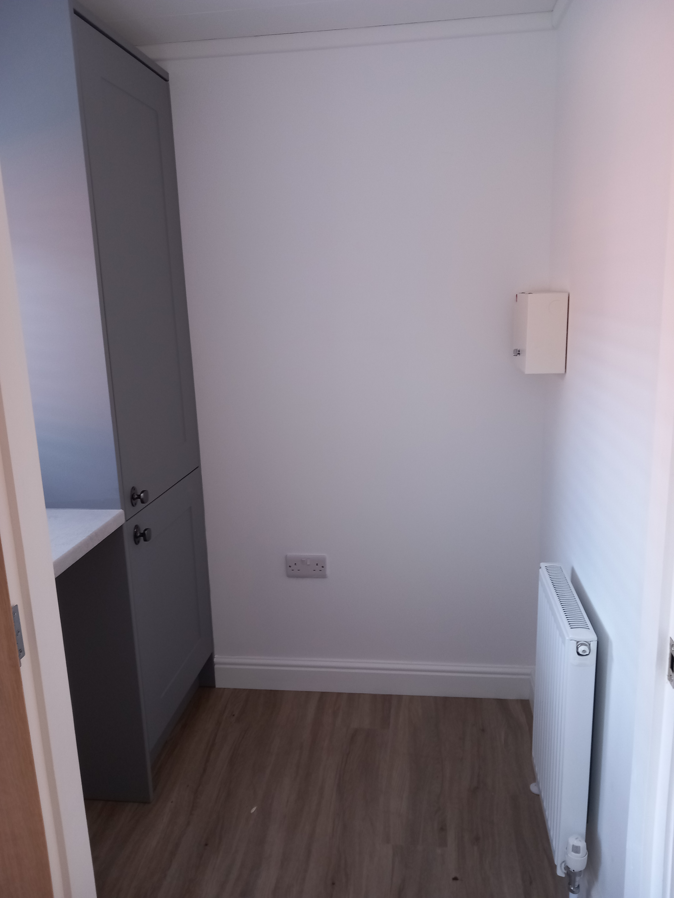

Slide 10
Where the lodge is
The lodge is based in Carnforth
Carnforth is in Lancashire, near the lakes, Lancaster and Morecambe
The area around the lodge is peaceful and quiet .
The lodge is just over 1 hour in a car from Bury
You can get the train from Manchester to Carnforth
The lodge is in easy reach of the town centre

Slide 11
Information about the lodge
In the lodge there is 3 bedrooms , a kitchen , a front room and a bathroom
the lodge is wheelchair friendly
The lodge is brand new and nicely decorated
The lodge is all on 1 level
2 bedrooms have double beds and the 3rd bedroom is for a wheelchair person and will be equipped with a hoist
There is a gym just facing it

